Slide 1


OBINexus Heart-Constitution Model
OBINexus Nnamdi Michael Okpala - When Infrastructure Collapses, I built my OWN
2025/05/01

Slide 2








Heart & Nexus
Governance by Coherence
Three-Tier Model
Life-Work Balance Engine
Constitutional Economics

Slide 3
Scale & Impact
Call to Heart

Slide 4

PART
01
Heart & Nexus

Slide 5

OBI = Heart
Nexus = Connection
OBI fuses Igbo “heart/soul” with Latin “nexus” to name an ecosystem where human dignity is the constitutional core and every node is a living connection.
The brand is not metaphor but executable governance that routes life-before-work policy through ring-topology sectors.

Slide 6

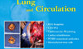
Traditional Model (CSR Add-on)
Why Heart-First Constitution?
Care is an afterthought, disconnected from core business logic and legal frameworks.
Traditional firms treat care as CSR; OBINexus embeds cardiac logic into IP, contracts, and code so protection is compiled, not appended.
The heart becomes a machine-verifiable instruction set that auto-activates when neurodivergent or disabled safety drops below the critical threshold.
OBINexus Model (Heart-Compiled)
Care is the core compiler, integrating dignity into every aspect of the ecosystem.

Slide 7
PART
02
Three-Tier Model

Slide 8
Tier 1: The Open Source Heart
The public pulse of the ecosystem. A global, collaborative foundation where value flows back as telemetry to train the constitutional model.
Open-Source Repos: Global contributors fork and improve housing, legal, and computing modules.
Sensory-Infra SaaS: Polyglot toolchains (aliased t1) provide essential services without vendor lock-in.
Telemetry Feedback: Usage data flows back to continuously train and strengthen the constitutional AI.

Slide 9
Tier 2: Ring-Zone BusinessTokenized membership within six concentric, walkable ring-zones. Governance is peer-to-peer, so growth adds redundancy, not hierarchy. Ring 1 IWU Council Ring 2 Legal & Community Ring 3 Schools & Education Ring 4 Public Housing & Work < Key Principle: All zones within a 2.5-mile walkable radius to integrate life and work.

Slide 10
Tier 3: Cryptographic Passports
Tier 3a: Uche Access
Tier 3b: Eze Access
Grants knowledge-keys to partner counties, allowing them to collaborate on projects and plug into the OBINexus infrastructure.
Issues safety-critical sovereignty keys for projects affecting daily life, ensuring compliance and constitutional coherence.
For Collaborative Projects
For Safety-Critical Sovereignty

Slide 11
PART
03
Constitutional Economics

Slide 12
Housing Leases
Revenue Logic of Care
Revenue is generated through housing, IP, and SaaS. A mandatory 25% of every transaction is auto-routed to the Universal Pension Allocation.
IP Licensing
Other Services
This makes care not just profitable, but a compulsory and integrated part of the business model.
Tiered SaaS
25% to Universal Pension Allocation

Slide 13
Cost Structure of Dignity
Major costs are treated as fixed assets that appreciate through community cohesion data, creating an antifragile balance sheet where social capital directly uplifts financial capital.
Smart-Home Hardware
Legal & Code Audits
Ring-Network Energy

Slide 14
PART
04
Governance by Coherence

Slide 15
AuraSeal: The 95.4% Coherence Metric
A cryptographic heartbeat that samples cross-division data. If coherence drops below 95.4%, the seal triggers an automated constitutional response.
95.4%
Coherence
Self-Healing Forks: Automatic system correction.
Threshold for Action
Permission Rerouting: Instant access lockdown and recovery.
Emergency Funds: Immediate resource allocation.

Slide 16
Governance by Orientation, Not Command
OBIAxis acts as the ecosystem's "Queen Bee," an epistemological alignment authority. It orients evolution through knowledge, not executive power, preventing any single leader from hijacking the heartbeat.
Knowledge Mapping
Pattern Recognition
Cross-Pollination
Documents where knowledge exists.
Identifies emerging opportunity spaces.
Facilitates knowledge transfer.

Slide 17
PART
05
Life-Work Balance Engine

Slide 18
The Life-Work Balance Engine
Foundation Track
Aspiration Track
Secures the non-negotiables: housing, mental health, and sensory safety. This is the base upon which everything else is built.
Hosts personal and professional growth: career, creativity, and social impact. This is where individuals thrive.
Career Advancement
Creative Projects
Social Impact Initiatives
Housing Security
Mental Health Support
Sensory Safety Protocols
An if-then policy engine automatically downgrades workload when Foundation sensors detect risk, preventing burnout before humans notice.

Slide 19
Neurodivergent-First Protocol
All project pipelines inherit safety protocols by default. Agile sprints are replaced with heart-rate-synced cycles that respect attention residue, making the ecosystem safe for autism, ADHD, and PTSD neurowiring.
Graduated Witnessing Membranes
Transition Warnings & Noise Thresholds

Slide 20
PART
06
Scale & Impact

Slide 21
Scale: From Pilot to County
Starting with 15 homes on 25 acres, the model scales ring-by-ring. Each new zone replicates constitutional firmware, proving small heart-nodes can upgrade entire regions.
15 Homes
Ring Expansion
County Level
25 Acre Pilot
Firmware Replication
Living Charter

Slide 22
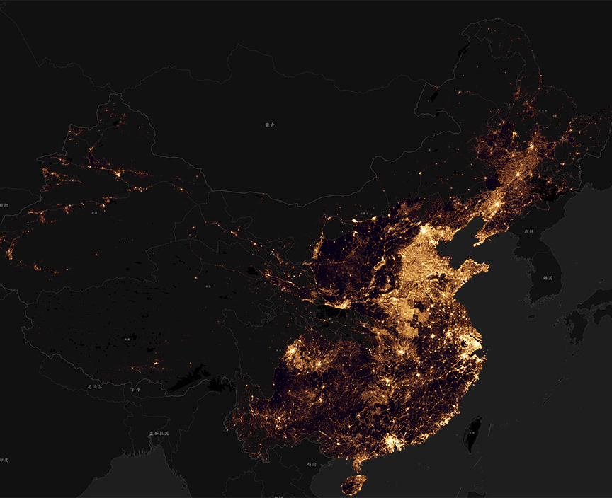
Global Partnership Path
Cities facing housing crises can license the three-tier stack. By plugging into OBINexus, they inherit a full suite of constitutional defenses.
License the Stack: Easy integration of the three-tier model.
Plug Local Data into AuraSeal: Inherit constitutional protections.
Issue Uche Keys: Extend the ecosystem with sovereign control.

Slide 23
PART
07
Call to Heart

Slide 24

Invest in Heart Infrastructure
OBINexus offers equity, debt, and tokenized care-bonds. Returns scale with social-coherence dividends, turning heart-aligned capital into measurable antifragility and replicable dignity technology.
Equity
Debt
Care-Bonds

Slide 25

THANK YOU
Kimi AI
2025/05/01

